Slide 1
Singularity Invariant
Transformations in
Stewart Plaforms
(Part I)
Federico Thomas

Slide 2
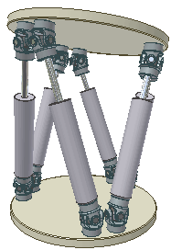
Goal
Stewart-Gough platforms are 6-DOF parallel manipulators consisting of 6 legs joining a base to a platform
In general, its forward kinematics and singularity analysis are difficult
Is it possible to change the location of the attachments without altering singularities?

Slide 3
Goal
The transformations must be one-to-one
The forward kinematics of the platform is essentially the same
Is it possible to change the location of the attachments without altering singularities?

Slide 4
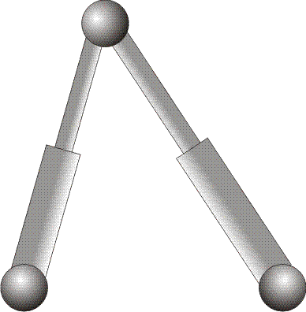
Goal
This would be useful to generate families of kinematically equivalent platforms…
…by transforming well-studied platforms, without changing their singularities and without changing their forward kinematics.
From the practical point of view, this could be useful, for example, to avoid multiple spherical joints

Slide 5
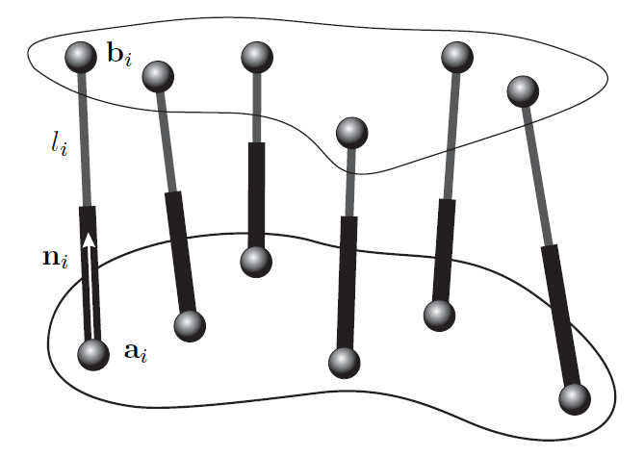
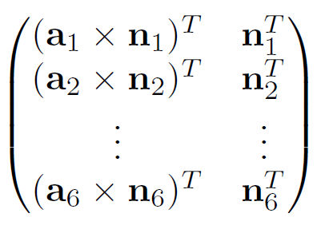
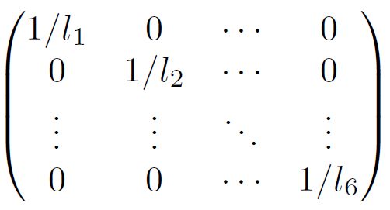
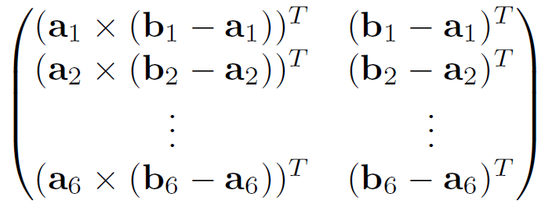
Singularities
SINGULARITIES

Slide 6
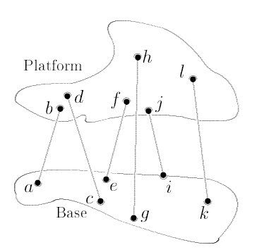
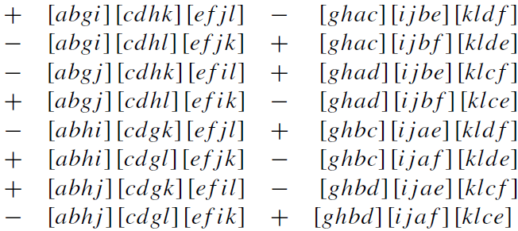
The Pure Condition
The Pure Condition
SINGULARITIES
48 volumes of tetrahedra
It can be simplified when attachments are coincident
either in the base or the platform

Slide 7
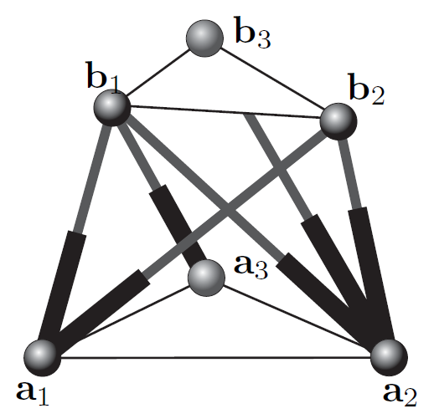
The Pure Condition
3-2-1
Octahedral

Slide 8
Reformulating our Goal
Find out transformations that multiply the pure condition by a constant

Slide 9
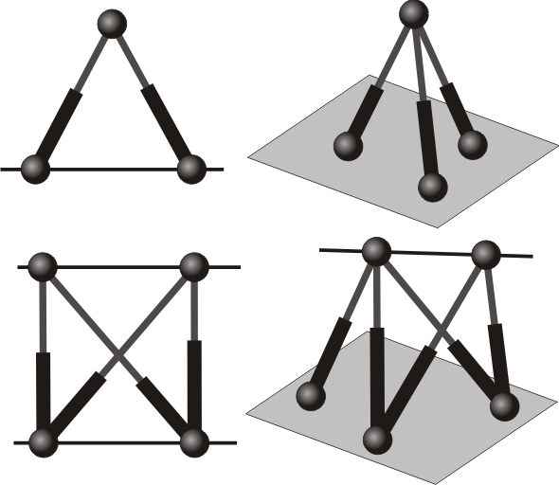
Let’s start by studying components
Components: rigid substructures between linear geometric entities.
Substitution of legs without changing the relative position between the involved geometric entities (points, lines or planes).
3 legs: point-plane
2 legs: point-line
5 legs: line-plane
4 legs: line-line

Slide 10
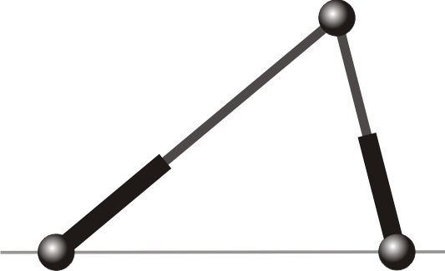
Point-Line Transformation
m
n
The length of the new leg can be found uniquely

Slide 11
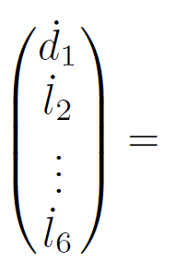
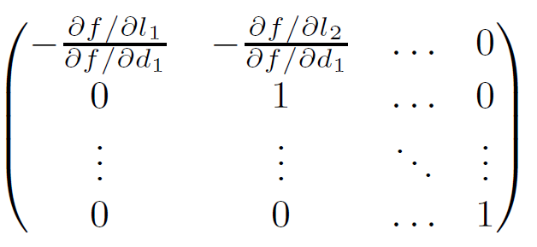
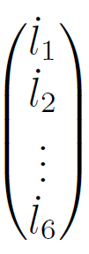
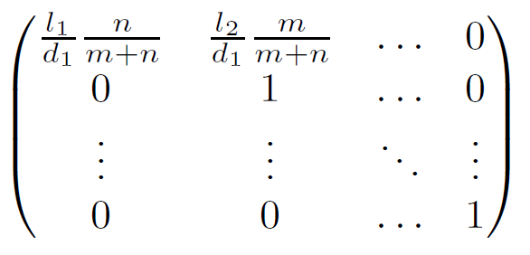
Point-Line Transformation

Slide 12
Point-Line Transformation

Slide 13
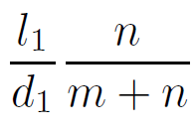
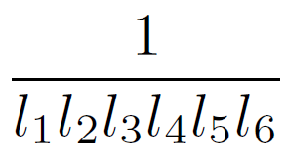
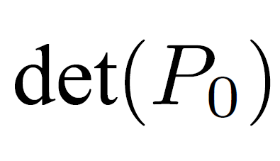
Point-Line Transformation
We got the first singularity invariant transformation!
SINGULARITIES

Slide 14
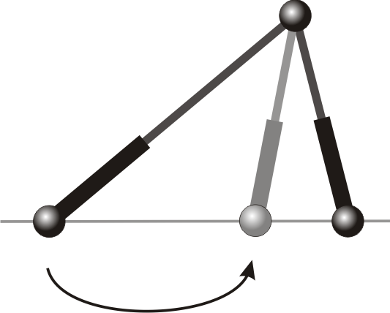
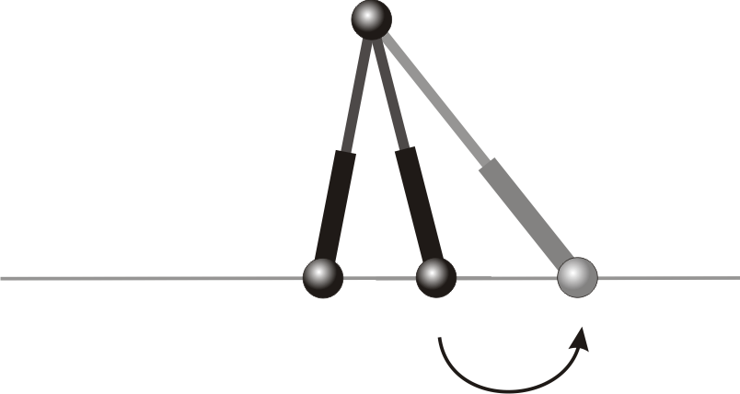
Point-Line Transformation
m
n
r

Slide 15
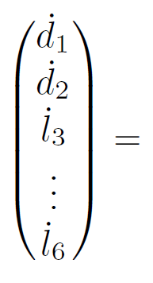
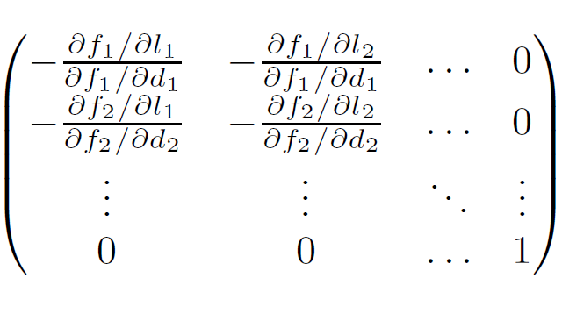
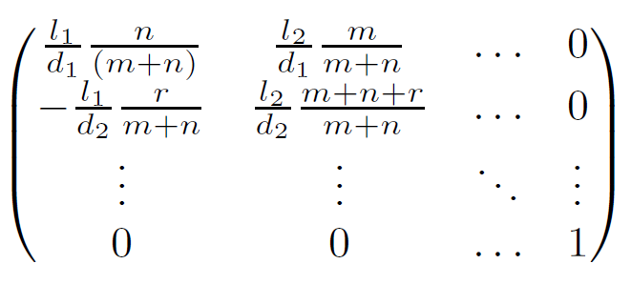
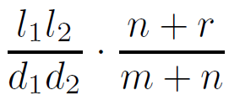
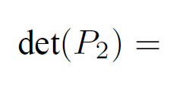
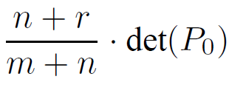
Point-Line Transformation
m
n
r

Slide 16
Point-Line Transformation
Sometimes these transformations
can only be applied simultaneously!!

Slide 17
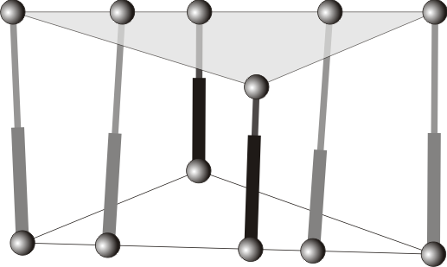
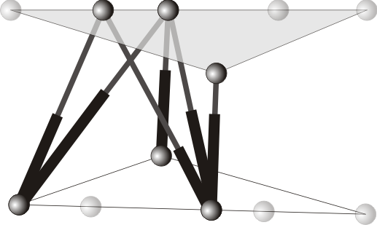
Example I: The Zhang-Song Platform
Zhang-Song Platform
Basic Flagged Platform

Slide 18
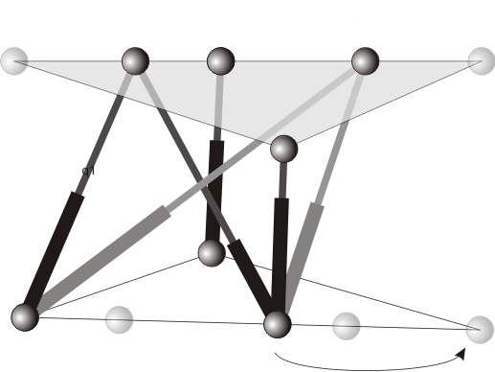
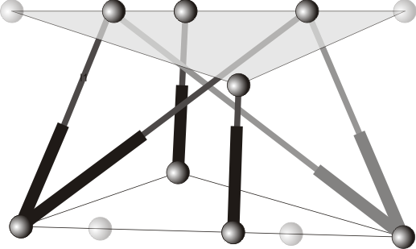
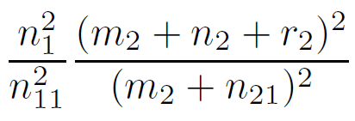
Example I: The Zhang-Song Platform

Slide 19
Example I: The Zhang-Song Platform
All these transformations have to be performed at the same time!!!

Slide 20
Example I: The Zhang-Song Platform
Can this factor be zero?

Slide 21
Example I: The Zhang-Song Platform
CROSS-RATIO 1
CROSS-RATIO 2
If this happens, the platform becomes architecturally singular!!!

Slide 22
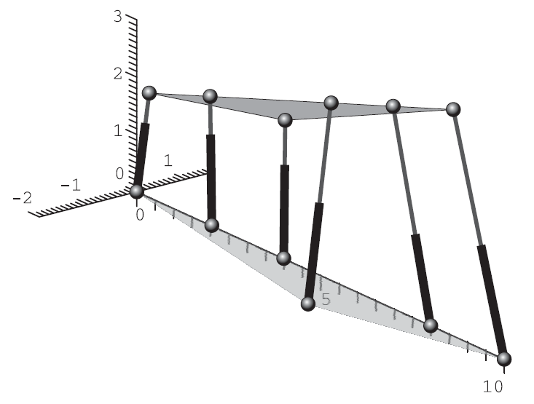
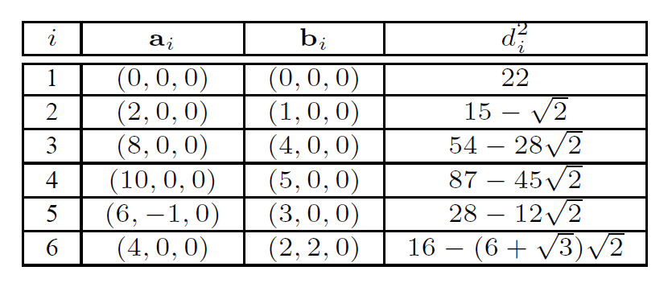
Example I: The Zhang-Song Platform

Slide 23
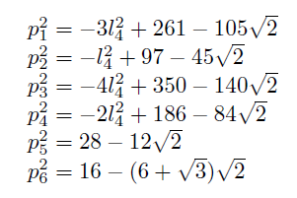
Example I: The Zhang-Song Platform

Slide 24
Example I: The Zhang-Song Platform

Slide 25
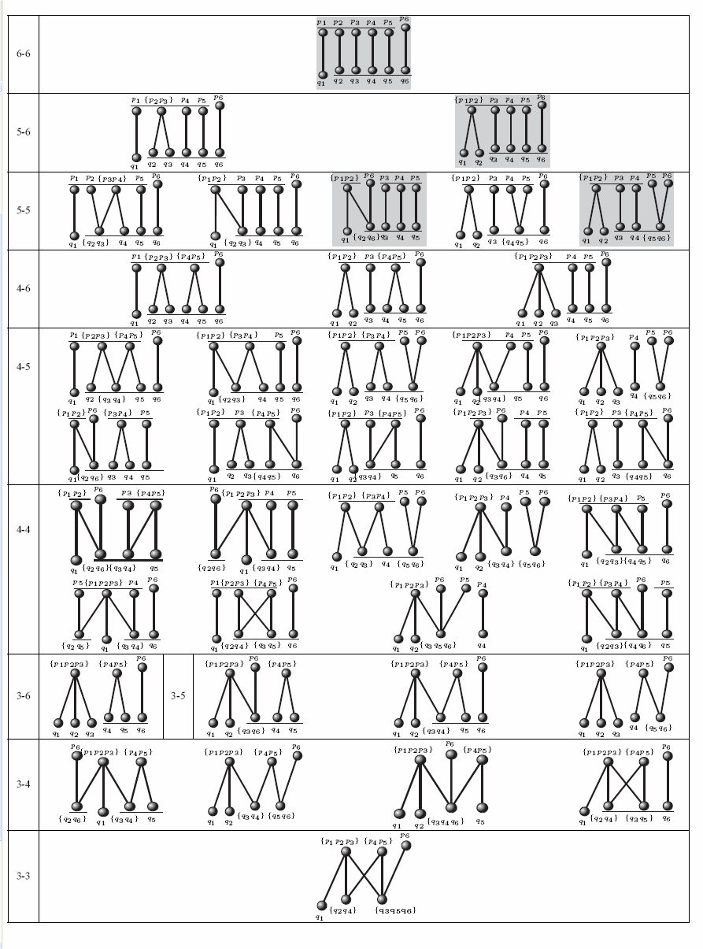
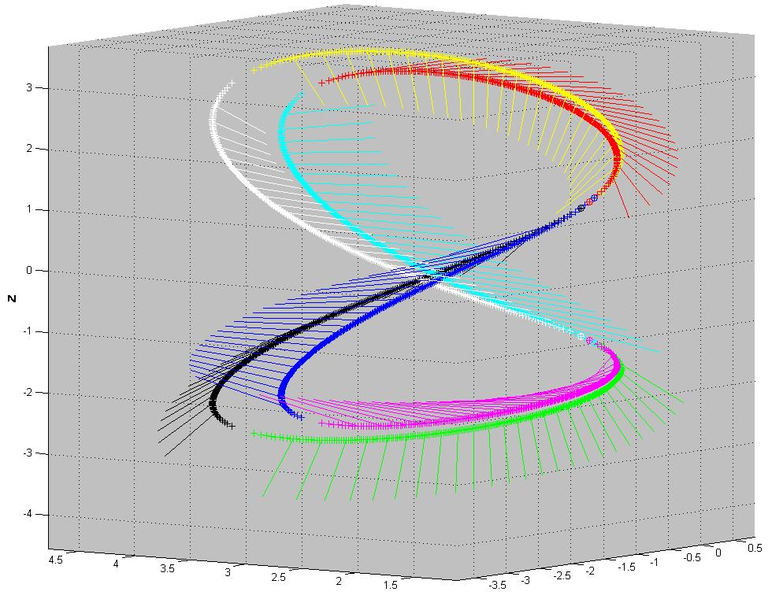
The Family of Flagged Platforms
Manipulators that can be architecturally singular.
If they satisfy the singularity condition,
they have a self-motion.
The closed-form solution gives the
parametrization.

Slide 26
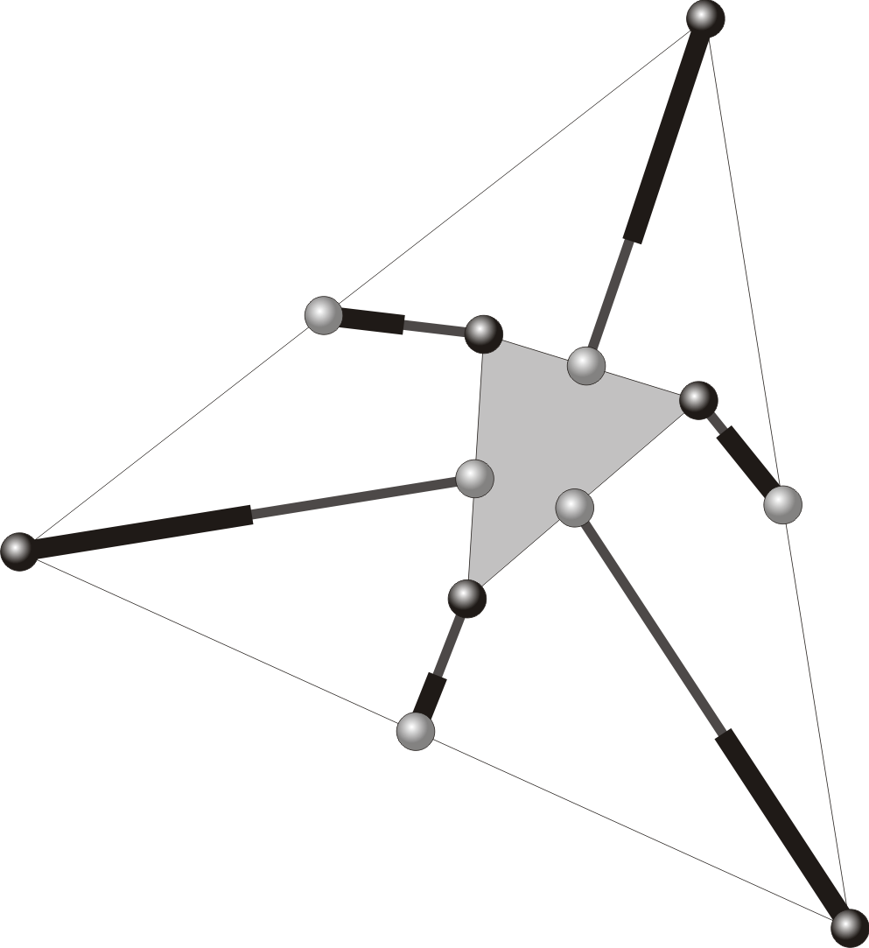
Example II: The Griffis-Duffy Platform

Slide 27
Example II: The Griffis-Duffy Platform
Can this factor be zero?

Slide 28
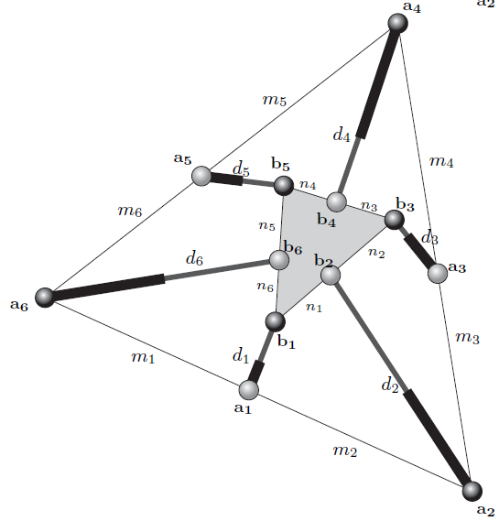
Example II: The Griffis-Duffy Platform

Slide 29
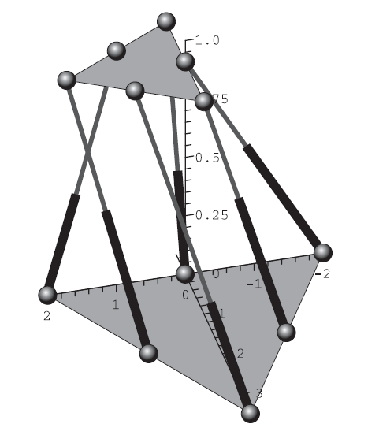
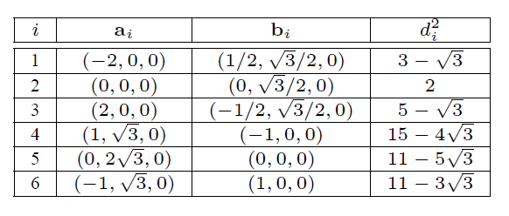
Example II: The Griffis-Duffy Platform

Slide 30
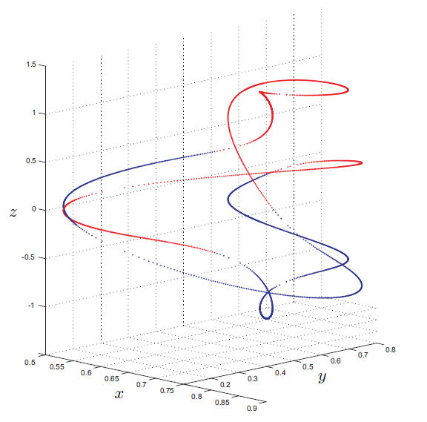
Example II: The Griffis-Duffy Platform

Slide 31
Example II: The Griffis-Duffy Platform

Slide 32
Homework
Prove that the point-plane and the line-line transformations can be reduced to point-line transformations
3 legs: point-plane
2 legs: point-line
5 legs: line-plane
4 legs: line-line

Slide 33
Conclusions
The application of singularity invariant transformations seems a promising tool for the analysis of Stewart platforms but …
… are there other transformations than the
point-line transformation?
As a by-product of our analysis, we have been able to
characterize architechtural singularities and
their associated selfmotions

Slide 34
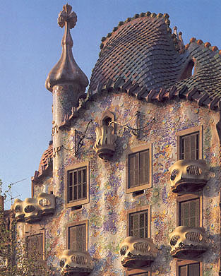
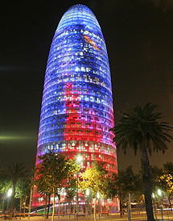
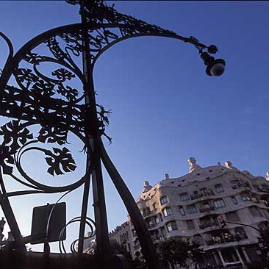
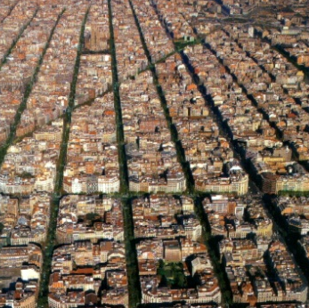
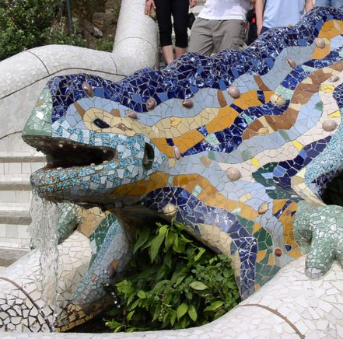
Thank you
Federico Thomas (fthomas@iri.upc.edu)
Institut de robòtica i informàtica industrial.
Barcelona

